Slide 1
Google Maps App
Apps-a-thon 2022

Slide 2
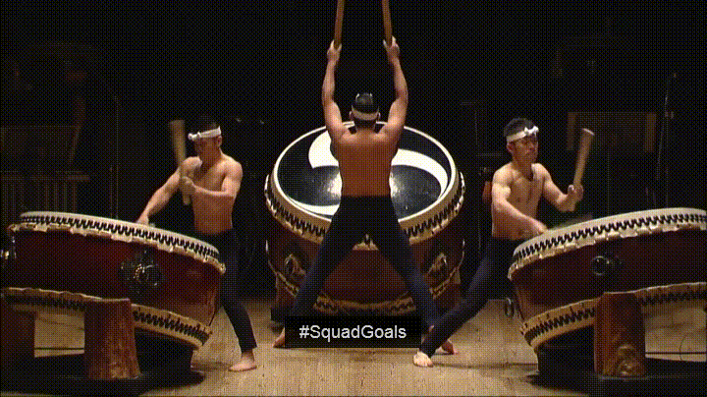
The Team

Slide 3
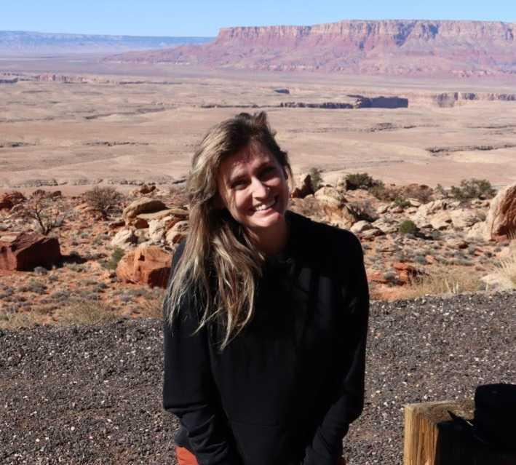
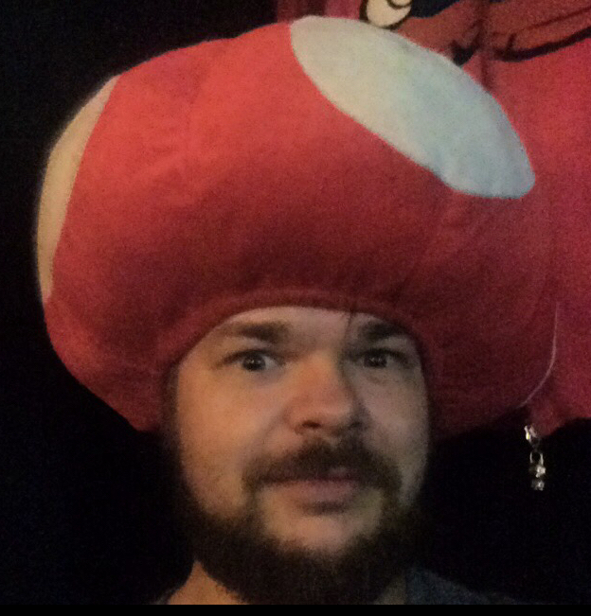
Developer
Sponsor
Steph Simpson
Olly Lord

Slide 4

The App -
Maps

Slide 5
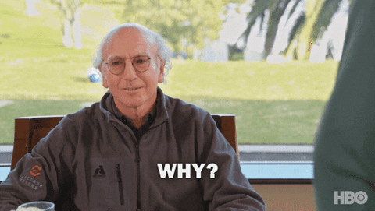
So, why did we do a Google Maps App?
Google Maps is the most popular online mapping tool. Having an app will give our customers that familiar look & feel.
Our target market is primarily SMBs. Whilst they may have products to share online, they often have a physical ‘bricks and mortar’ location too.
Larger, international firms have multiple locations. We want them to show their customers where they are.
Adding maps was a common ‘custom’ feature in the Classic Builder, but the inability to see the map in the editor provided a poor UX/UI. We want them to see how the map looks from the very start.

Slide 6
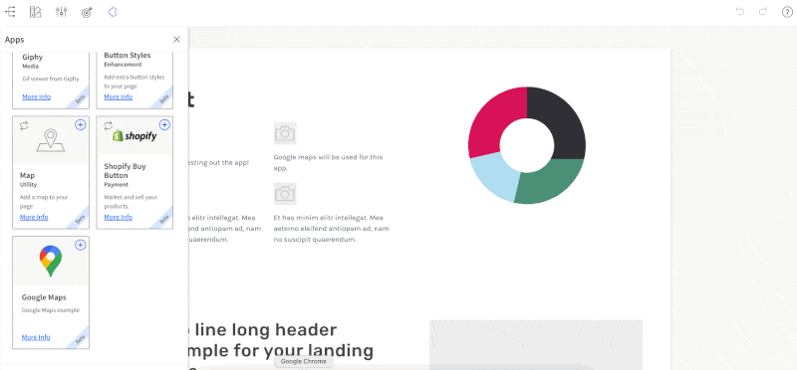
STEP 1 SELECT YOUR TEMPLATE

Slide 7
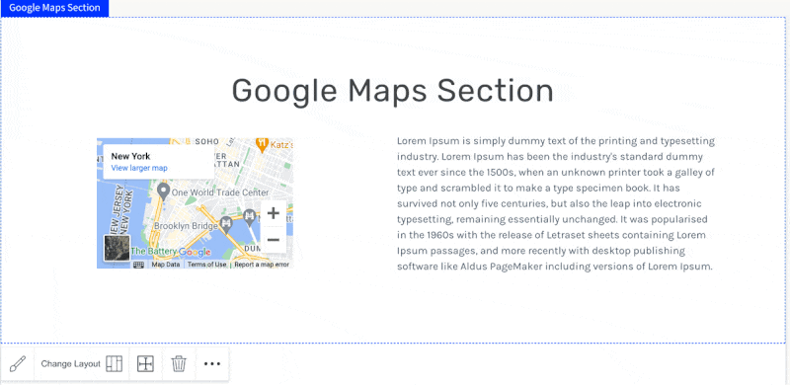
STEP 2 CUSTOMIZE!

Slide 8

STEP 3 SIT BACK AND RELAX!

